Slide 1
Consumer Goods Ad_Hoc Request Insights

Slide 2
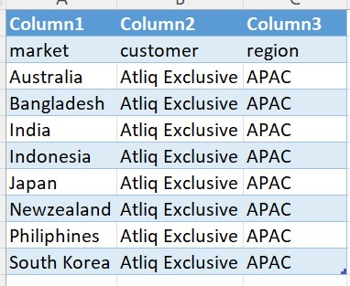
Request 1.
Provide the list of markets in which customer "Atliq Exclusive" operates its business in the APAC region.
Result:

Slide 3
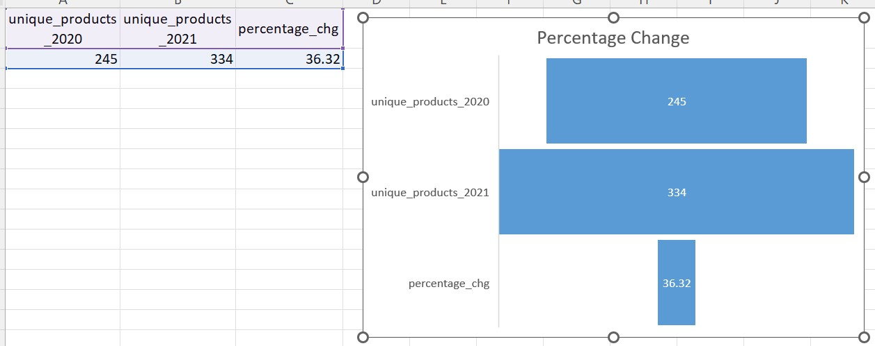
Request 2.
What is the percentage of unique product increase in 2021 vs. 2020?
The final output contains these fields, unique_products_2020 unique_products_2021 percentage_chg.
Result: Compared to 2020 the unique products increased by 36.32% in 2021.

Slide 4
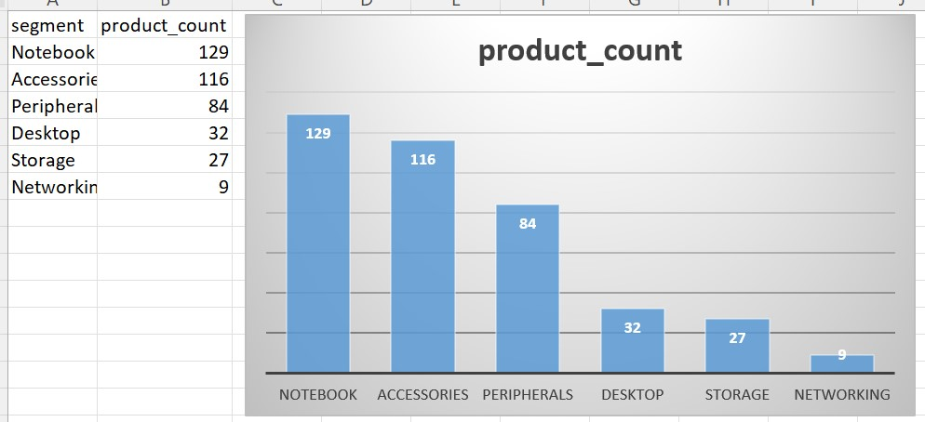
Request 3.
Provide a report with all the unique product counts for each segment and sort them
in descending order of product counts. The final output contains 2 fields, segment and product_count.
Result: Notebook Segment has the highest unique product count which is 129, Networking has the lowest unique product count of 9.

Slide 5
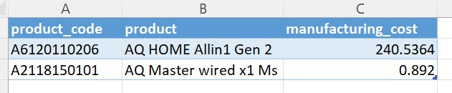
Request 4.
Get the products that have the highest and lowest manufacturing costs.
The final output should contain these fields, product_code product manufacturing_cost.
Result: AQ Home Allin1 has the highest manufacturing cost of 240.53
AQ Matser wired x1 has the lowest manufacturing cost of 0.892

Slide 6
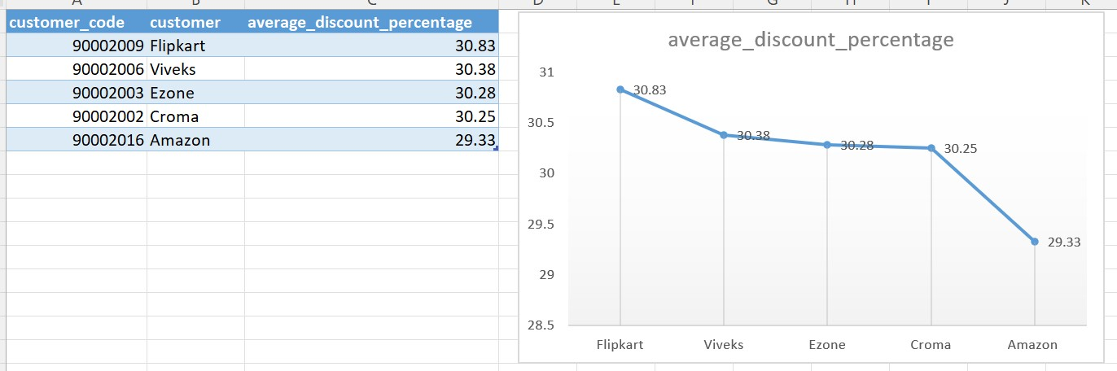
Request 5.
Generate a report which contains the top 5 customers who received
an average high pre_invoice_discount_pct for the fiscal year 2021 and in the Indian market.
The final output contains these fields, customer_code customer average_discount_percentage.
Result: In the Indian market Flipkart has the highest average discount % of 30.83%

Slide 7
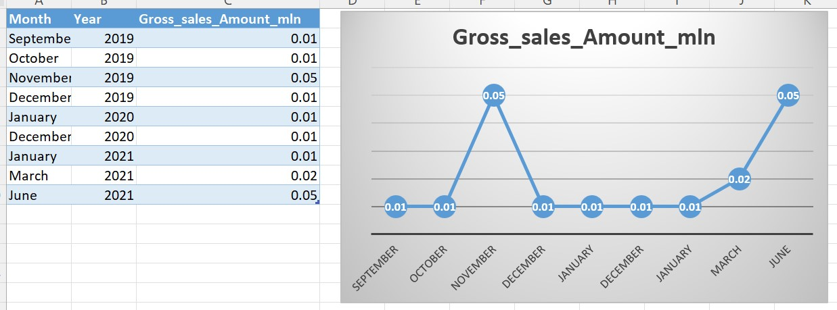
Request 6.
Get the complete report of the Gross sales amount for the customer “Atliq Exclusive” for each month .This analysis helps to get an idea of low and high-performing months and take strategic decisions. The final report contains these columns: Month Year Gross sales Amount.
Result:

Slide 8
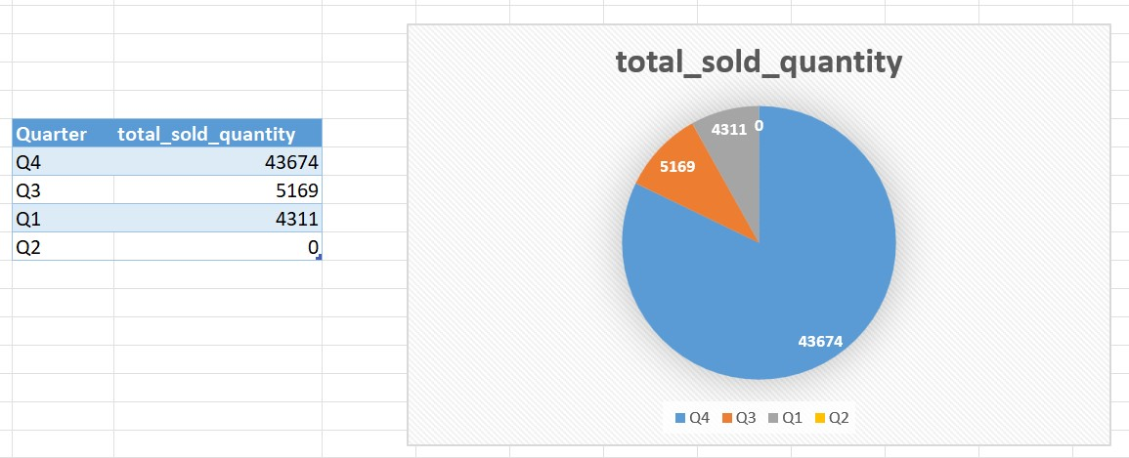
Request 7.
In which quarter of 2020, got the maximum total_sold_quantity?
The final output contains these fields sorted by the total_sold_quantity, Quarter total_sold_quantity.
Result: Q4_2020 has the maximum total_sold_quantity of 43674.

Slide 9
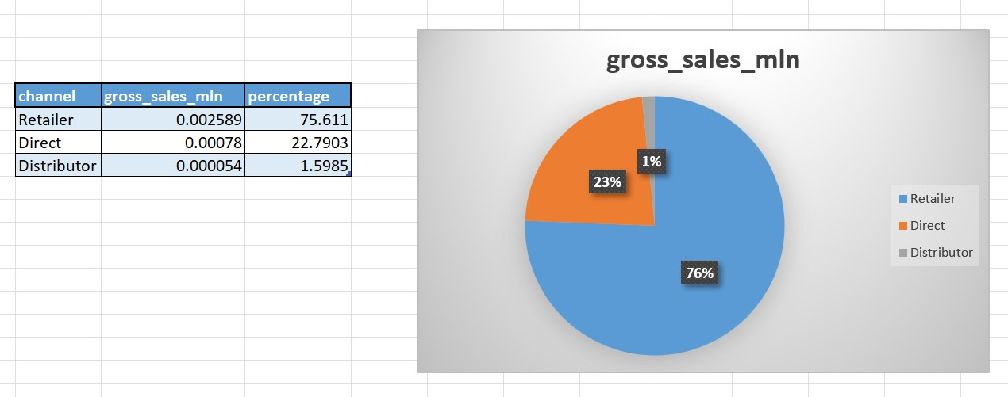
Request 8.
Which channel helped to bring more gross sales in the fiscal year 2021 and the percentage of contribution? The final output contains these fields, channel gross_sales_mln percentage.
Result: “Retailer” helped to bring more gross sale in fiscal year 2021. which accounts to 75.61% of the total gross sales.

